Slide 1
Reducing and Adjusting for Non-Response Bias
Benjamin Chu
Biomath 204
3/15/2017

Slide 2
What is Non-Response Bias?
Error due particular population not responding to poll. 2 kinds:
Unit non-response – refuses to take survey
Item non-response – 1 question empty
N_T = N_R + N_M

Slide 3

Surveying is trash in trash out
Acquiring a good dataset is as important as analyzing them!!
i.e. Must account for sampling errors and various forms of biases.

Slide 4
4 approaches to mitigate nonresponse bias

Slide 5
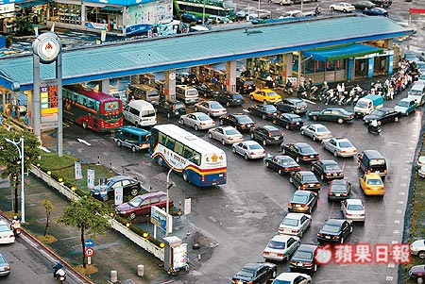
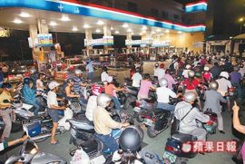
Project motivation
http://enochtsui.pixnet.net/blog/post/22484205
http://web2.yzu.edu.tw/e_news/506/
Q: What are people’s refueling habits?

Slide 6

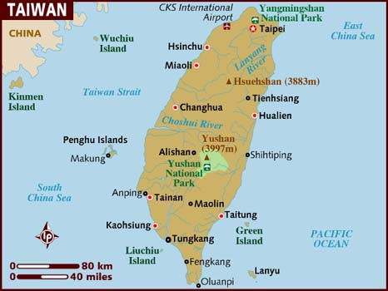
Taiwan and CPC Corp.
Imports >97% gas consumed
CPC distributes >70% of all gas
http://www.lonelyplanet.com/maps/asia/taiwan/

Slide 7
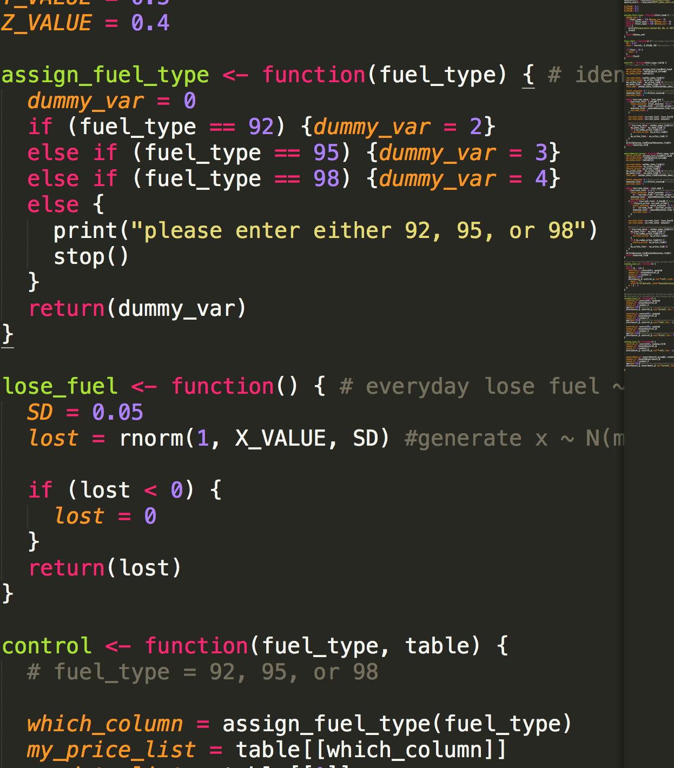
Use survey results in a Simulation
Everyday people lose X% fuel,
X ~ N(10, 5²)
Control group – no refueling strategy
Others – various “simple” strategy

